Slide 1
AIRBNB CASE ANALYSIS -by Srija Gupta

Slide 2
1. What value proposition does AirBnB offer its customers? How does AirBnB make money?
Airbnb is an online platform that offers affordable private space for the travelers. It allows the owners of the space to list their property online and earn rental money.
Airbnb’s revenue model: They charge the guest with 6-12% of booking fee & the host with 3% after successful transaction.
Expenditure: Platform design & maintenance , marketing.
By providing host protection insurance, as well as a rating and review system, the platform builds trust within the community of users and lowers transaction costs.
Takes no cancellation charges.

Slide 3
How could you calculate potential revenue of a property on Airbnb using the available data?
Assuming reviews as the number of people who actually stayed at the property and taking the min_stay as the average number of days stayed.
Revenue can be calculated by multiplying price*reviews*min_stay . This is the baseline revenue that was calculated, and can vary if we had the data for the actual days of stay and

Slide 4
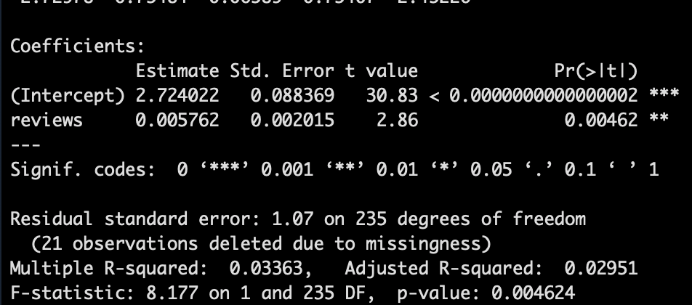
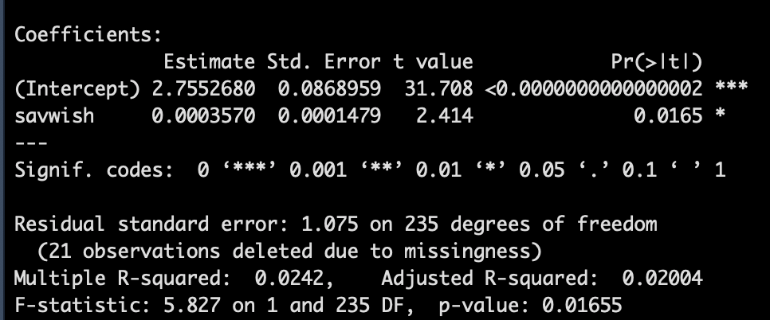
3. How does a review's sentiment affect a property's potential to be rented on AirBnB ?
With the increase in sentiment’s value, the number of reviews increase and number of savwish increases, independently.

Slide 5
4. What are the key drivers of AirBnB property revenues in Miami and Paris?
We see that the following factors affect price and thus revenue of Airbnb-
Miami : weekfee, monthfee,bedroom,securitydeposit,savwish,extpeople
Paris: beds

Slide 6
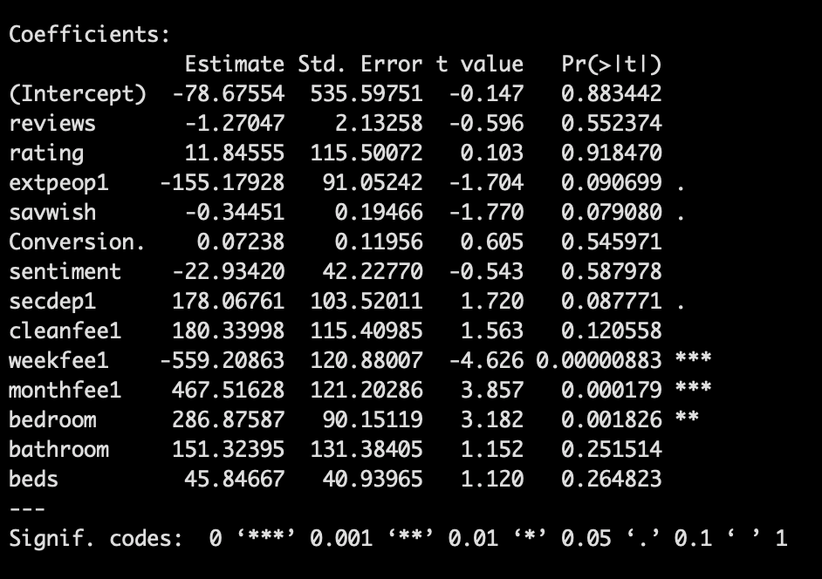
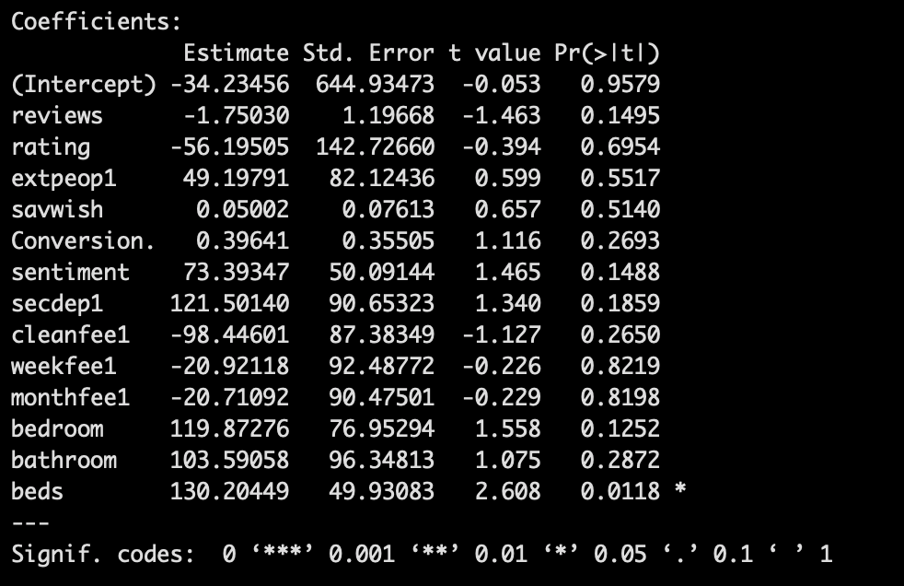
MIAMI Dependent: rev | PARIS Dependent var :rev

Slide 7
5.How will you optimize Airbnb property revenues in Miami and Paris? Are your strategies different or same in the two cities?
Yes Airbnb should have region specific strategies.
We should focus weekfee, monthfee, bedroom,security deposit,savwish, extpeople
for Miami and beds for Paris.
Also, we see that expected avg revenue for Miami is greater than that for Paris.

Slide 8
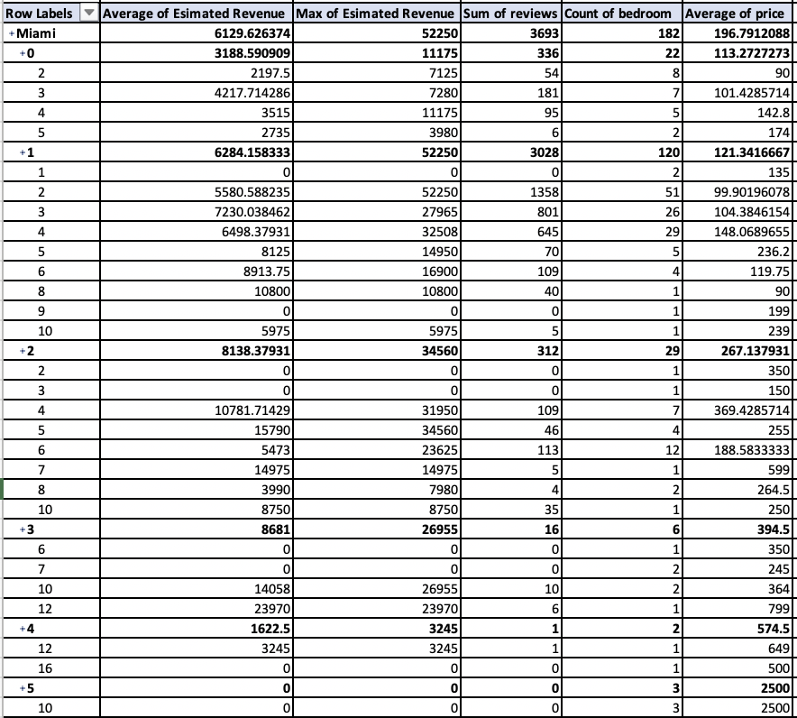
For Miami, we see that the maximum average revenue comes from 3 bedroom apartment.
Max estimated revenue comes from 1 bedroom with 2 accommodates

Slide 9
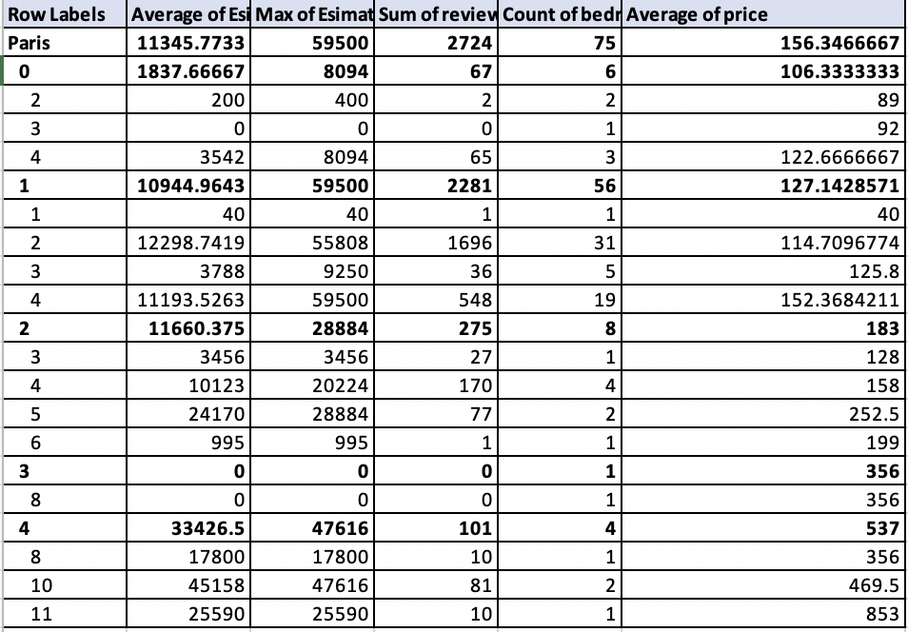
For Paris, the maximum average estimated revenue comes from four
and maximum of estimated revenue comes from zero bedroom with 4 accommodates

